Slide 1
Hub Scanner-ATOMIC HOST integration

Slide 2

Enterprise-grade security and compliance with Black duck and Red Hat
Risk Visibility and Control for Open Source and Components
Enterprise-Grade Benefits:
Adopt Containers and PaaS with trust and confidence
Move from Test/Dev to Production
Use Containers and PaaS for high-value and security-sensitive applications
Address needs of CISOs and Security teams to identify and control risks
Use established Black Duck technology proven with over 1,800 customers
Black Duck Hub
+
OpenShift by Red Hat
Red Hat Enterprise Linux (RHEL) and Atomic Host
Platform for Applications and Containers

Slide 3
IDENTIFY, REMEDIATE, and CONTROL RISKS IN CONTAINER CONTENTS with Black duck hub
Identify and control risks across the entire container stack — from application components to patch versions of the underlying operating system
Discovery of Open Source and Known Vulnerabilities: Rapid scanning and identification of open source components in use and mapping to their known security vulnerabilities, license, and operational risks
Remediation Orchestration: Open source vulnerability remediation prioritization, and mitigation guidance
Policy Enforcement: Automated policy management to prevent deployment of unsafe or non-compliant containers
Continuous Monitoring for New Security Vulnerabilities: Ongoing monitoring and alerting on newly reported open source security vulnerabilities associated with open source in use

Slide 4
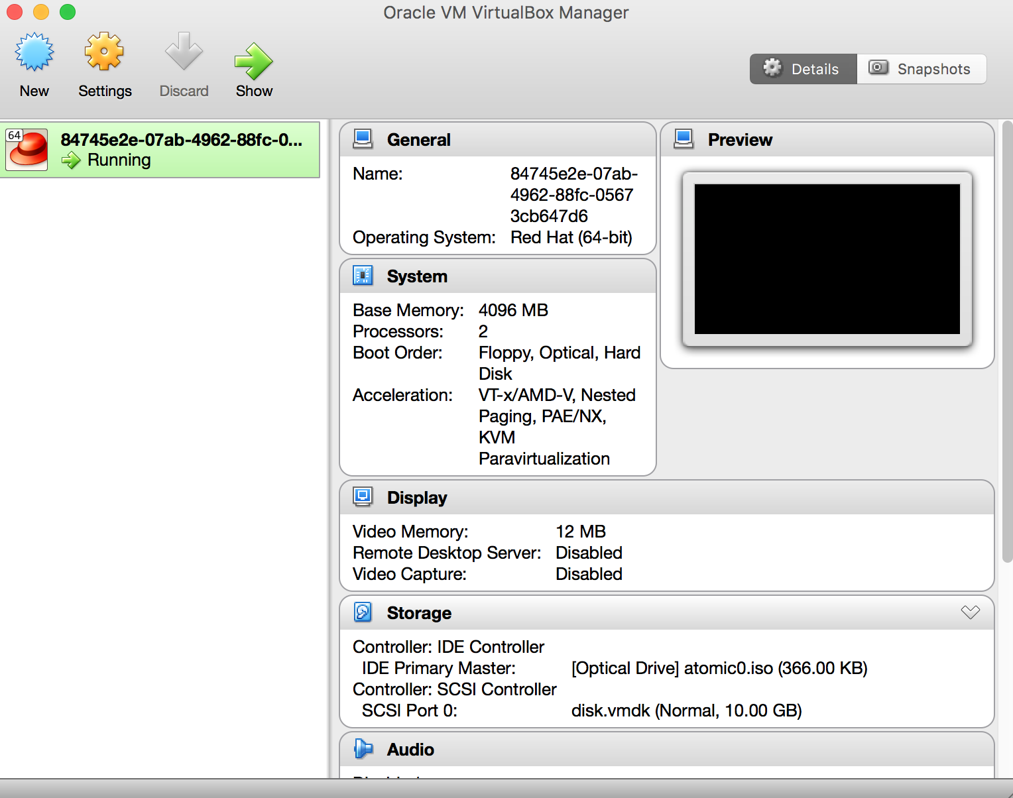
Integration workflow - STEP 1
Deploy the Atomic Host .OVA image (rhel-atomic-cloud-7.2.5.x86_64.vsphere.ova) in a Virtualization Client like Virtual Box
Notes:
Download link:
http://dl.dropboxusercontent.com/u/1445590/rhel-atomic-cloud-7.2.5.x86_64.vsphere.ova
Scripts and Atomic0.iso also available here:
https://github.com/tschoots/doc_rhsummit_image
Download link is also in the scatchpath.txt

Slide 5
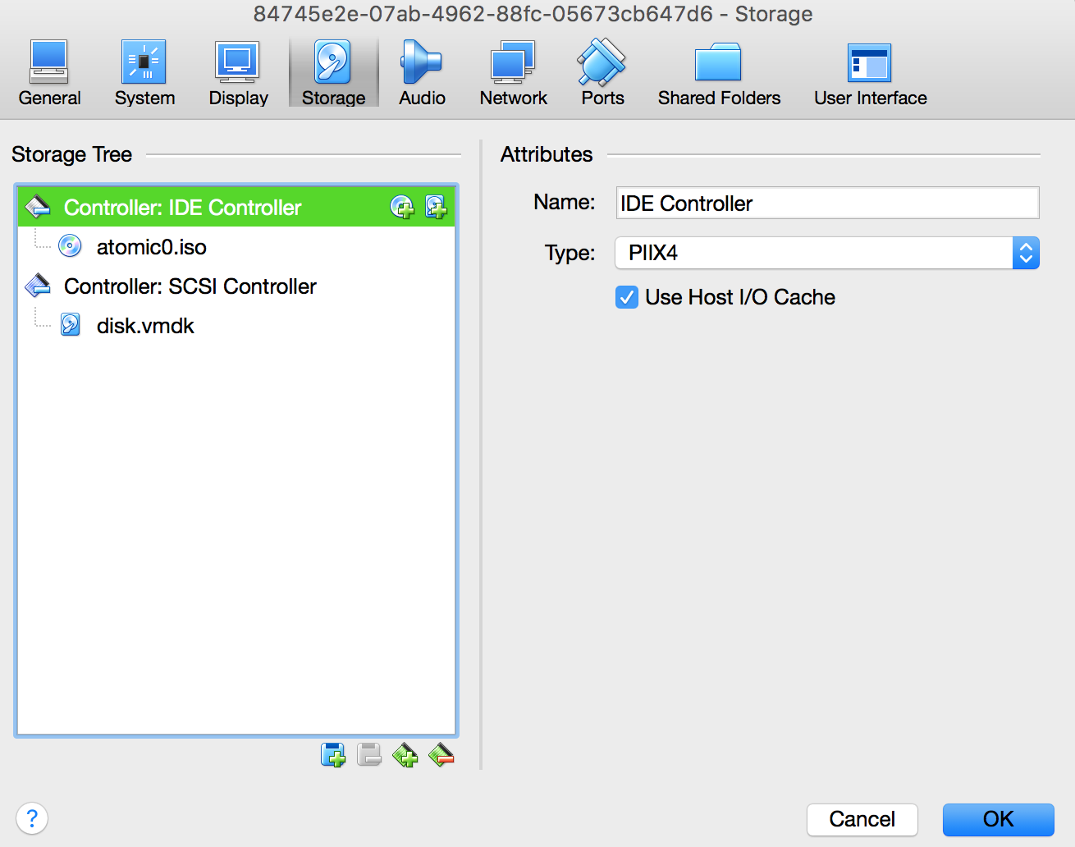
Integration workflow - STEP 2
Add the atomic.iso to the Optical disk
Notes:
Download link:
https://github.com/tschoots/doc_rhsummit_image/blob/master/atomic0.iso

Slide 6
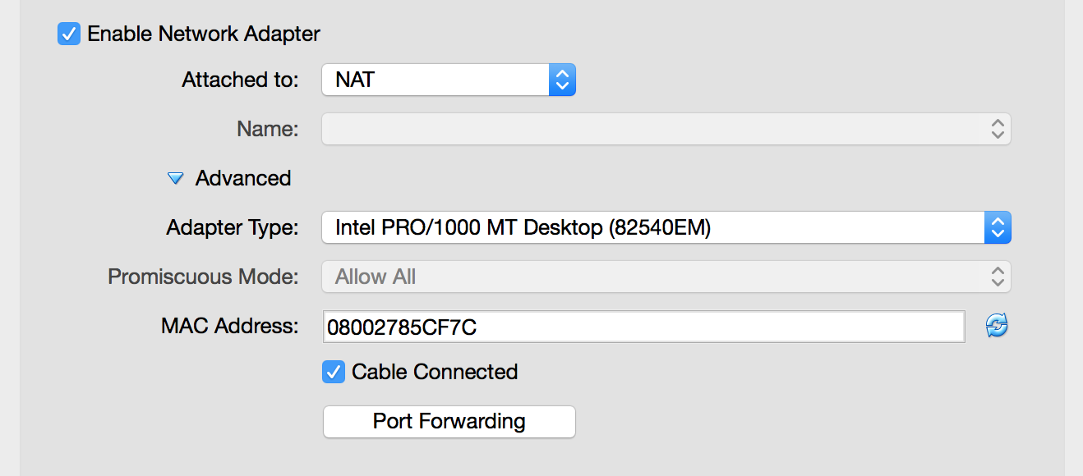
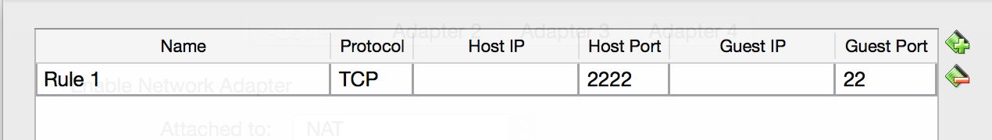
Integration workflow - STEP 3
Update the Network settings in the VM to facilitate ssh from the terminal*
*Using the terminal to facilitate ease of using atomic commands

Slide 7
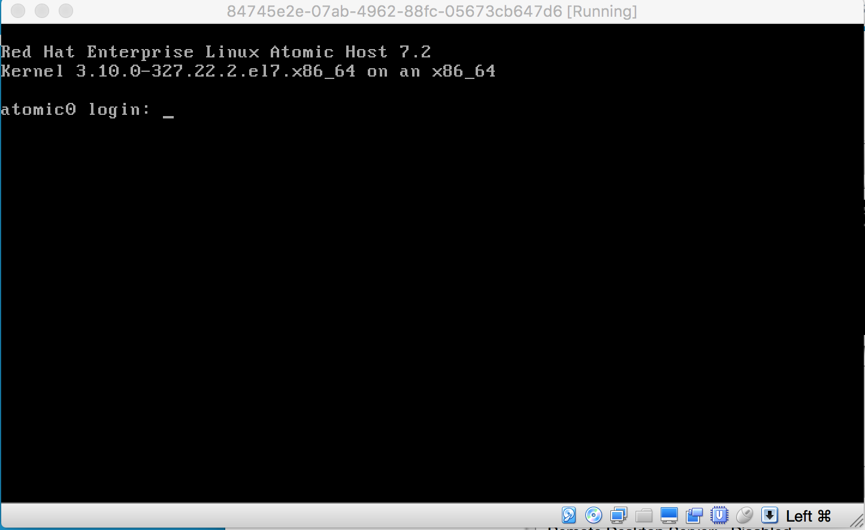
Integration workflow - STEP 4
Login on the VM, credentials: root/redhat
>vi /etc/ssh/sshd_config & change PasswordAuthentication to “yes”.
>Bounce sshd:
>systemctl restart sshd

Slide 8
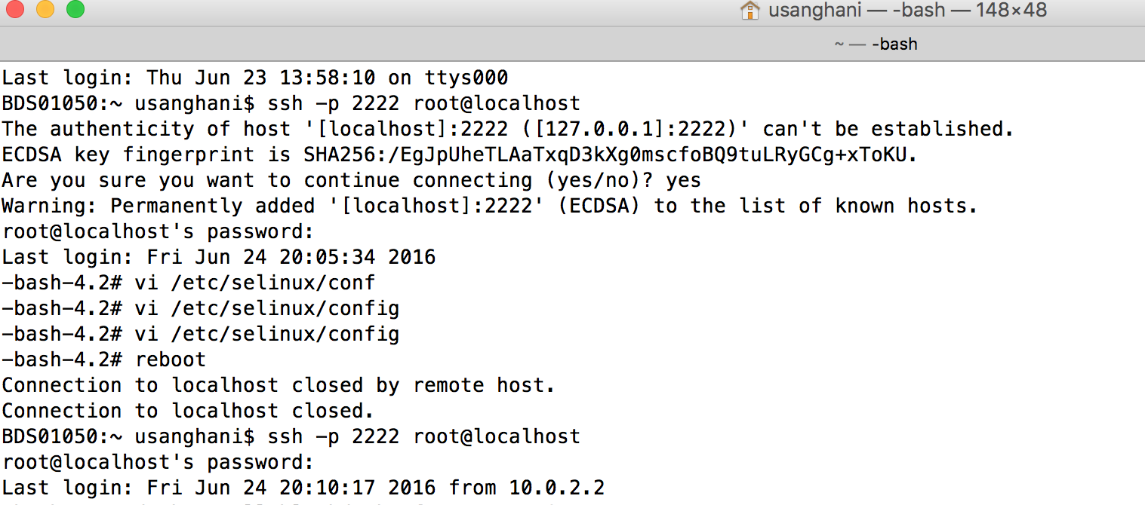
Integration workflow - STEP 5
SSH into the VM and disable SELinux using vi /etc/selinux/config & reboot

Slide 9
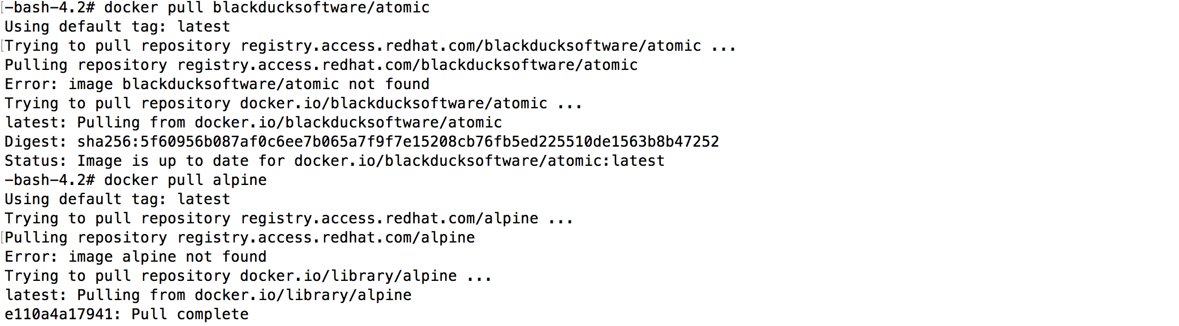
Integration workflow - STEP 6
Load/pull a docker image. Here, we are pulling an alpine image from Docker’s registry

Slide 10
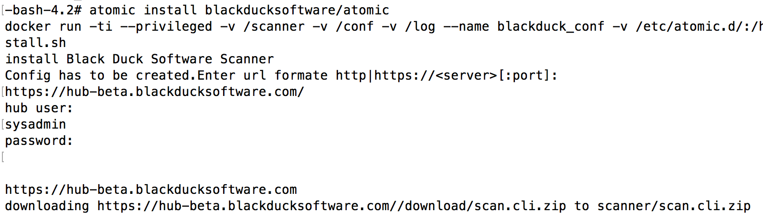
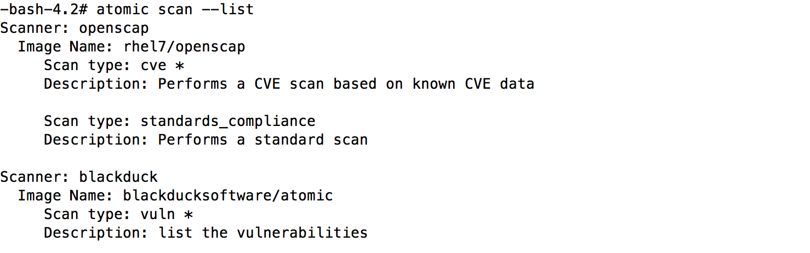
Integration workflow - STEP 7
Install the Black Duck Hub Scanner on Atomic Host

Slide 11
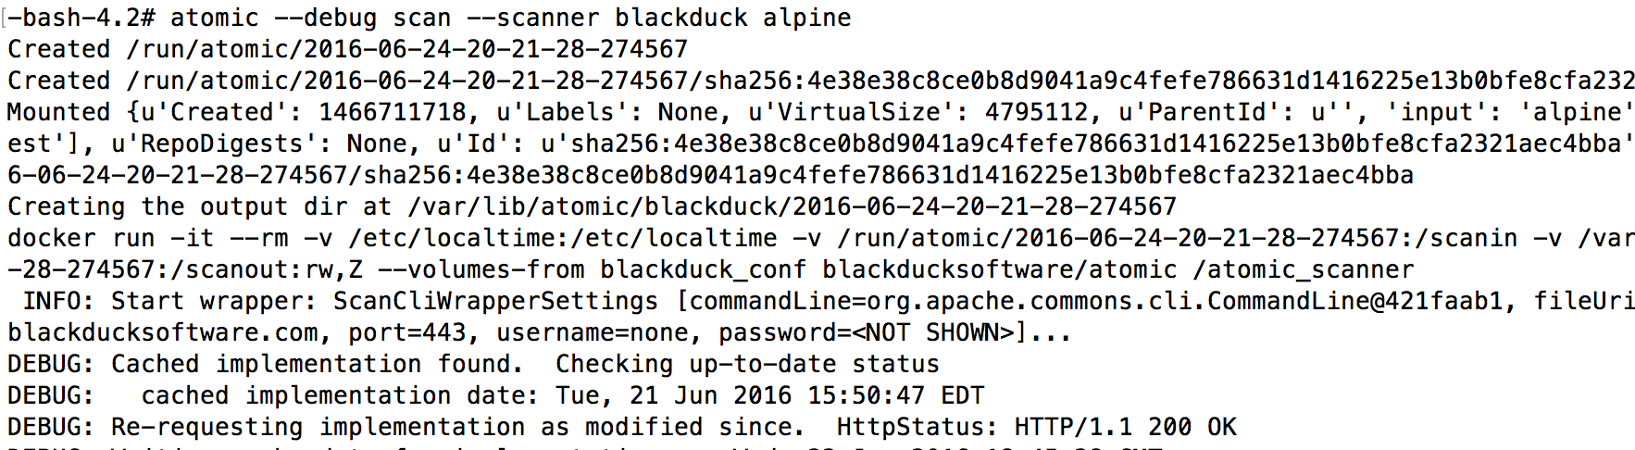
Integration workflow - STEP 8
Scan the alpine image with the Black Duck Hub Scanner

Slide 12
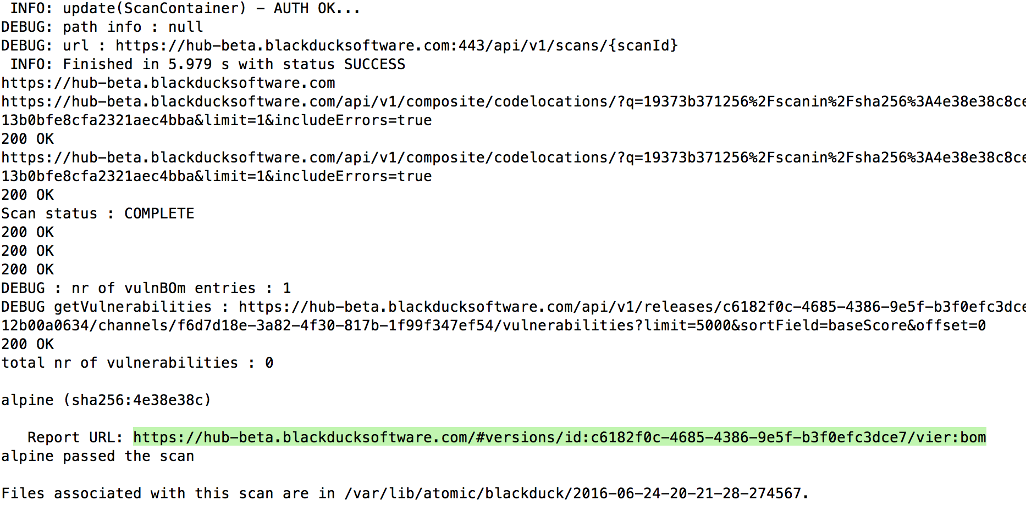
Integration workflow - STEP 9
Scan status & URL to the Bill of Materials (BoM) of the scanned Docker image

Slide 13
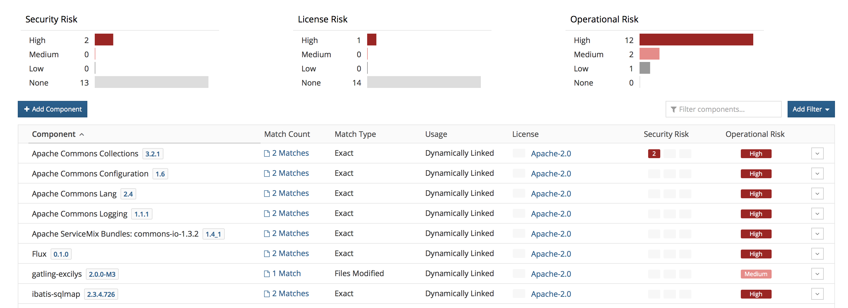
Integration workflow - STEP 10
Sample O/P - Bill of Materials (BoM)

Slide 14
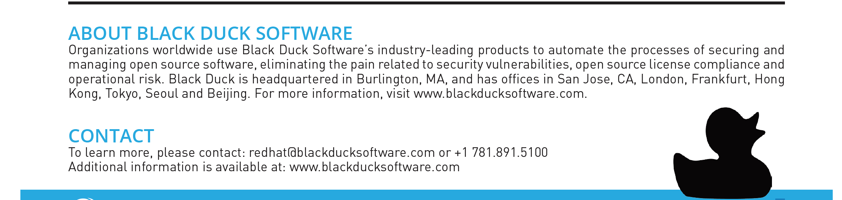
Thank you!

